Slide 1
4.7 Data Hazards: Forwarding versus Stalling
4.8 Control Hazards

Slide 2
Structure Hazards
When a planned instruction cannot execute in the proper clock cycle because the hardware does not support the combination of instructions that are set to execute.

Slide 3
Structure Hazards
Consider we have a single memory (or cache) for both Instructions and Data
Need to access the same memory to fetch instructions as well as for LDUR/STUR
LDUR X1, [X0,#0]
IF
Decode
Exec
Mem
WB
ADD X3, X2, X4
IF
Decode
Exec
Mem
WB
SUB X10, X10, #8
IF
Decode
Exec
Mem
WB
CBZ X10, loop
IF
Decode
Exec
Mem
WB
LDUR X1, [X0,#0]
IF
Decode
Exec
Mem
WB
ADD X3, X2, X4
IF
Decode
Exec
Mem
WB
SUB X10, X10, #8
IF
Decode
Exec
Mem
WB
CBZ X10, loop
Stall
IF
Decode
Exec
Mem
WB

Slide 4
Structure Hazards
Conflict for use of a resource
This problem can be eliminated using separate Instruction and Data memories (or caches)
In general, we can eliminate Structural hazards by using more resources
This may be very expensive in some cases
In more complex systems, we may have only one floating point divide unit
which takes longer than other instructions
If we have two divide instructions in a row, we may have to stall the second divide

Slide 5
Data Hazard
When a planned instruction cannot execute in the proper clock cycle because data that are needed to execute the instruction are not yet available.

Slide 6
Data Hazards
An instruction depends on the Result from a previous instruction
ADD X1, X2, X3 // X1 is written in WB stage SUB X4, X1, X5 // X1 is read in ID stage
ADD X1, X2, X3
IF
Decode
Exec
Mem
WB
IF
Decode
Will read old value of X1
SUB X4, X1, X5
stall
Exec
Mem
WB
MUL X7, X4, X9
IF
Decode
Exec
Mem
WB
Will read old value of X4
ADD X1, X2, X3
IF
Decode
Exec
Mem
WB
IF
Decode
SUB X4, X1, X5
stall
Stall
Stall
Exec
Mem
WB
MUL X7, X4, X9
IF
Decode
Stall
Stall
Exec
Mem
WB
We delayed SUB 2 cycles so that ADD writes X1 and then SUB reads new value
We also need to delay the MUL so that X4 has the new value

Slide 7
Data Hazards
Consider the problem 4.18. Initially X1 = 11 and X2 = 22
What would you expect the values in X3 and X4?
ADDI X1, X2, #5 // X1 = 22+5 = 27
ADD X3, X1, X2 // X3 = 27+22 = 49
ADDI X4, X1, #15 // X4 = 27+15 = 42
If hardware does not implement hazard detection and stalls
 | 1 | 2 | 3 | 4 | 5 | 6 | 7
ADDI X1, X2, #5 | IF | ID | EX | MEM | WB
ADD X3, X1, X2 |  | IF | ID | EX | MEM | WB
ADDI X4, X1, #5 |  |  | IF | ID | EX | MEM | WB
ADDI X1, X2, #5 // X1 = 22+5 = 27
ADD X3, X1, X2 // X3 = 11(X1) + 22(X2) = 33
ADDI X4, X1, #15 // X4 = 11(X1) + 15 = 26

Slide 8
Data Hazards
If hardware does not stall dependent instruction, we need to insert NOOP instructions
 | 1 | 2 | 3 | 4 | 5 | 6 | 7 | 8 | 9
ADDI X1, X2, #5 | IF | ID | EX | MEM | WB
NOOP |  | IF | ID | EX | MEM | WB
NOOP |  |  | IF | ID | EX | MEM | WB
ADD X3, X1, X2 |  |  |  | IF | ID | EX | MEM | WB
ADDI X4, X1, #5 |  |  |  |  | IF | ID | EX | MEM | WB
Now X1 is updated in cycle 5 and the new value can be read in the same cycle
So, ADD X3, X1, X2 can read correct value of X1 in its ID
ADD X4, X1, #5 also reads correct value of X1

Slide 9
Forwarding or Bypassing
A method of resolving a data hazard by retrieving the missing data element from internal buffers rather than waiting for it to arrive from programmer- visible registers or memory.

Slide 10
Forwarding (aka Bypassing)
Consider our previous example (4.18)
 | 1 | 2 | 3 | 4 | 5 | 6 | 7
ADDI X1, X2, #5 | IF | ID | EX | MEM | WB
ADD X3, X1, X2 |  | IF | ID | EX | MEM | WB
ADDI X4, X1, #5 |  |  | IF | ID | EX | MEM | WB
ADDI X1, X2, #5 // X1 = 22+5=27
ADD X3, X1, X2 // X3 = 27 (X2 +5) + 22(X2) = 49
ADDI X4, X1, #15 // X4 = 27 (X2 +5) + 15 = 42
Note: The value of X1 is not updated until Cycle 5, but X2+5 is available in Cycle 4
So, the next instruction can use this data in Cycle 4 to Execute

Slide 11
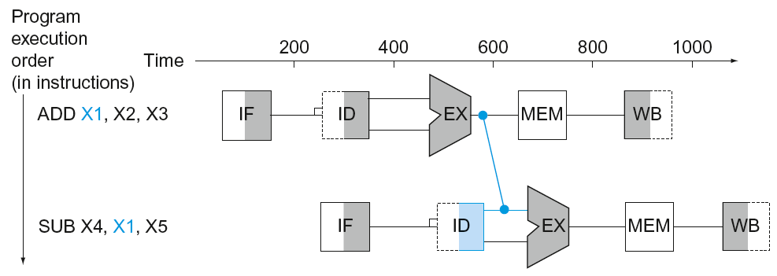
Forwarding (aka Bypassing)
A better way is to send the output of ALU to dependent instructions directly
When is the result of an R type instruction available?
Use result as soon as it is available
Don’t wait for it to be stored in a register (in Writeback stage)
Requires extra connections in the datapath

Slide 12
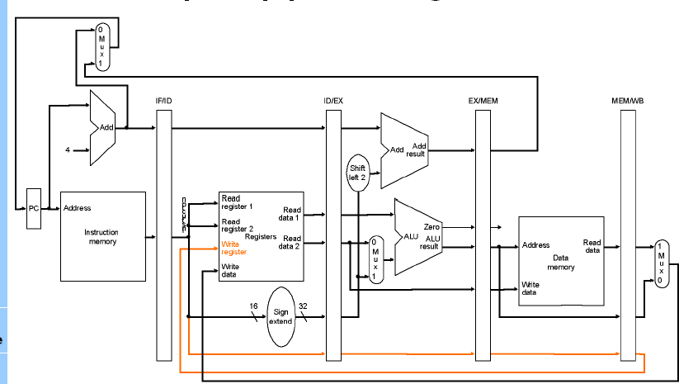
Forwarding (aka Bypassing)

Slide 13
Load Use Data Hazard
A specific form of data hazard in which the data being loaded by a load instruction have not yet become available when they are needed by another instruction.
pipeline stall Also called bubble. A stall initiated in order to resolve a hazard.

Slide 14
Load-Use Data Hazard
Can’t always avoid stalls by forwarding
If value is not computed when needed
Can’t forward backward in time!
CC1 CC2 CC3 CC4 CC5 CC6 CC7
LDUR X1, [X2,#0]
IF
Decode
Exec
Mem
WB
SUB X4, X1, X5
IF
Decode
Exec
Mem
WB
By the time LDUR has data from memory, SUB is already in EX (and would have used the old X1 value). So we have to Stall SUB in decode until LDUR can supply data
CC1 CC2 CC3 CC4 CC5 CC6 CC7 CC8
LDUR X1, [X2,#0]
IF
Decode
Exec
Mem
WB
SUB X4, X1, X5
IF
Decode
Stall
Exec
Mem
WB

Slide 15
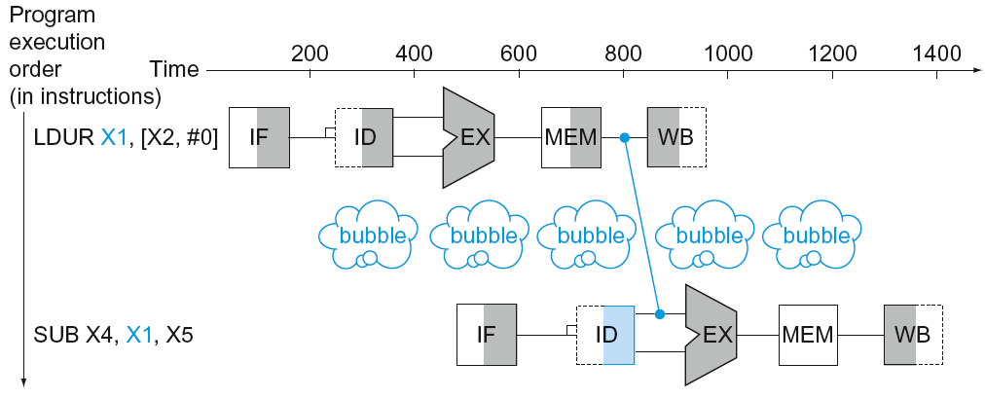
Load-Use Data Hazard
Can’t always avoid stalls by forwarding
If value not computed when needed
Can’t forward backward in time!
Note if hardware does not detect the dependency and stall, you need to use a NOOP
LDUR X1, [X2, #0]
NOOP
SUB X4, X1, X5

Slide 16
Code Scheduling to Avoid Stalls
Clock Cycle | 1 | 2 | 3 | 4 | 5 | 6 | 7 | 8 | 9 | 10 | 11
LDUR X1, [X0, #0] | IF | ID | EX | MEM | WB
LDUR X2, [X0, #8] |  | IF | ID | EX | MEM | WB
ADD X3, X1, X2 |  |  | IF | ID | EX | MEM | WB
LDUR X4, [X0, #16] |  |  |  | IF | ID | EX | MEM | WB
ADD X5, X1, X4 |  |  |  |  | IF | ID | EX | MEM | WB
STUR X3, [X0, #24] |  |  |  |  |  | IF | ID | EX | MEM | WB
STUR X5, [X0. #32] |  |  |  |  |  |  | IF | ID | EX | MEM | WB
Things to remember before changing the order of instructions
Must be careful about dependencies
For example, you cannot move STUR X3, [X0, #24] ahead of ADD X3, X1, X2
If the index register used in LDUR or STUR is modified, any reordering of LDUR/STUR may require adjustments to offsets

Slide 17
Code Scheduling to Avoid Stalls
Clock Cycle | 1 | 2 | 3 | 4 | 5 | 6 | 7 | 8 | 9 | 10 | 11
LDUR X1, [X0, #0] | IF | ID | EX | MEM | WB
LDUR X2, [X0, #8] |  | IF | ID | EX | MEM | WB
LDUR X4, [X0, #16] |  |  | IF | ID | EX | MEM | WB
ADD X3, X1, X2 |  |  |  | IF | ID | EX | MEM | WB
STUR X3, [X0, #24] |  |  |  |  | IF | ID | EX | MEM | WB
ADD X5, X1, X4 |  |  |  |  |  | IF | ID | EX | MEM | WB
STUR X5, [X0. #32] |  |  |  |  |  |  | IF | ID | EX | MEM | WB
By reordering the lines of code we can avoid a stall

Slide 18
Simple Assembly Code
C code D = A + B; E = B + C;
LDUR X1, [X0,#0]
LDUR X2, [X0,#8]
ADD X3, X1, X2
STUR X3, [X0,#24]
LDUR X4, [X0,#16]
ADD X5, X1, X4
STUR X5, [X0,#32]
// X1= A
// X2= B
Stall(or NOOP)
// X3= A+B
// D=X3= A+B
// X4=C
Stall(or NOOP)
// X5 = B+C
// E= X5 = B+C
9 cycles

Slide 19
Code Scheduling to Avoid Stalls
Reorder code to avoid use of load result in the next instruction.
C code for D = A + B; E = B + C;
LDUR X1, [X0,#0]
LDUR X2, [X0,#8]
ADD X3, X1, X2
STUR X3, [X0,#24]
LDUR X4, [X0,#16]
ADD X5, X1, X4
STUR X5, [X0,#32]
LDUR X1, [X0,#0]
LDUR X2, [X0,#8]
LDUR X4, [X0,#16]
ADD X3, X1, X2
STUR X3, [X0,#24]
ADD X5, X1, X4
STUR X5, [X0,#32]
stall
stall
9 cycles
Moved third LDUR before first ADD
7 cycles

Slide 20
Control Hazard
Occurs when the pipeline makes incorrect branch prediction decisions, resulting in instructions entering the pipeline that must be discarded.

Slide 21
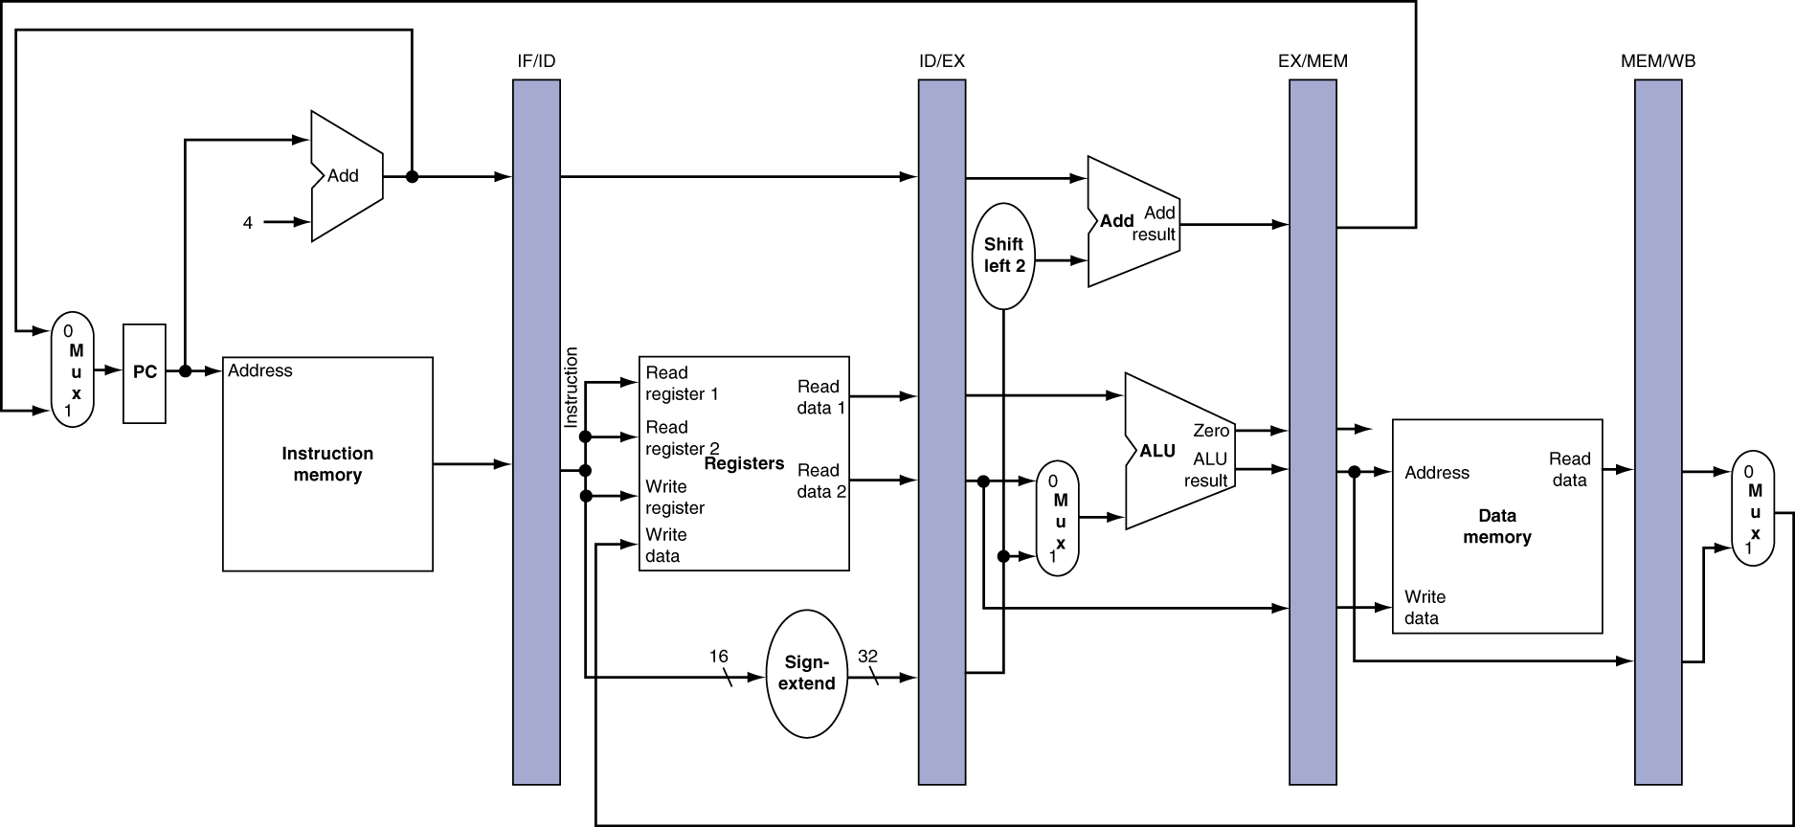
Control Hazards
Branch determines flow of control
Fetching next instruction depends on branch outcome
Pipeline can’t always fetch correct instruction
When do we know that we have a branch instruction?
When is the outcome of branch known?

Slide 22
Control Hazards
If the condition succeeds?
 | Cycle |  | 1 | 2 | 3 | 4 | 5 | 6 | 7 | 8 | 9
 | ADD X4, X5, X6 |  | IF | ID | EX | DM | WB
 | CBZ X1, LOOP |  |  | IF | ID | EX | DM | WB
 | ORR X7, X8, X9 |  |  |  | IF | STALL | STALL
LOOP | SHL X2, X2, #3 |  |  |  | X | X | IF | ID | EX | DM | WB
Loss of 2 cycles
Branch Prediction
Consider a simple idea: We will predict that branch WILL NOT BE TAKEN
We will start to execute the next instruction that follows the branch
So, fetch the next instruction, decode
By this time, we would know the decision of the branch
If our prediction is wrong, discard the instruction in the pipeline
Fetch the correct instruction from the branch destination

Slide 23
Control Hazards
If the condition fails (no branch taken)?
 | Cycle |  | 1 | 2 | 3 | 4 | 5 | 6 | 7 | 8 | 9
 | ADD X4, X5, X6 |  | IF | ID | EX | DM | WB
 | CBZ X1, LOOP |  |  | IF | ID | EX | DM | WB
 | ORR X7, X8, X9 |  |  |  | IF | ID | EX | DM | WB
 | (next instruction |  |  |  |  | IF | ID | EX | DM | WB
NO Loss
If the branch condition is true (branch taken)
 | Cycle |  | 1 | 2 | 3 | 4 | 5 | 6 | 7 | 8 | 9
 | ADD X4, X5, X6 |  | IF | ID | EX | DM | WB
 | CBZ X1, LOOP |  |  | IF | ID | EX | DM | WB
 | ORR X7, X8, X9 |  |  |  | IF | ID
LOOP | SHL X2, X2, #3 |  |  |  |  |  | IF | ID | EX | DM | WB
Loss of 2 cycles

Slide 24
Control Hazards
Computing CPI impact due to branches
Suppose branch frequencies are given as follows
15% of the code is Conditional Branches
60% of the time the branch is take
1% of the code is Unconditional Branches
taken 100% of the time (of course b/c they are unconditional)
We have a 5 stage pipeline as we saw.
If branch is not taken, we lose ZERO cycles.
If branch is taken, we lose 2 cycles
15% * 60% *2 + 1%*2 = 0.18+0.02 = 0.2 cycles lost.
So, if the CPI without branches is 1, now we have a CPI of 1.2

Slide 25
Control Hazards
We can also predict that the branch is always taken
Fetch instruction from branch target (How do we get the address?)
Decode
If branch is not taken, discard and start fetching correct instruction
These are called static branch prediction techniques
Ideally, we should associate a prediction with the branch itself
Backward branches (loops) are more likely to be taken
There are numerous very interesting “dynamic” prediction techniques will be explored in CSCE 4610

Slide 26
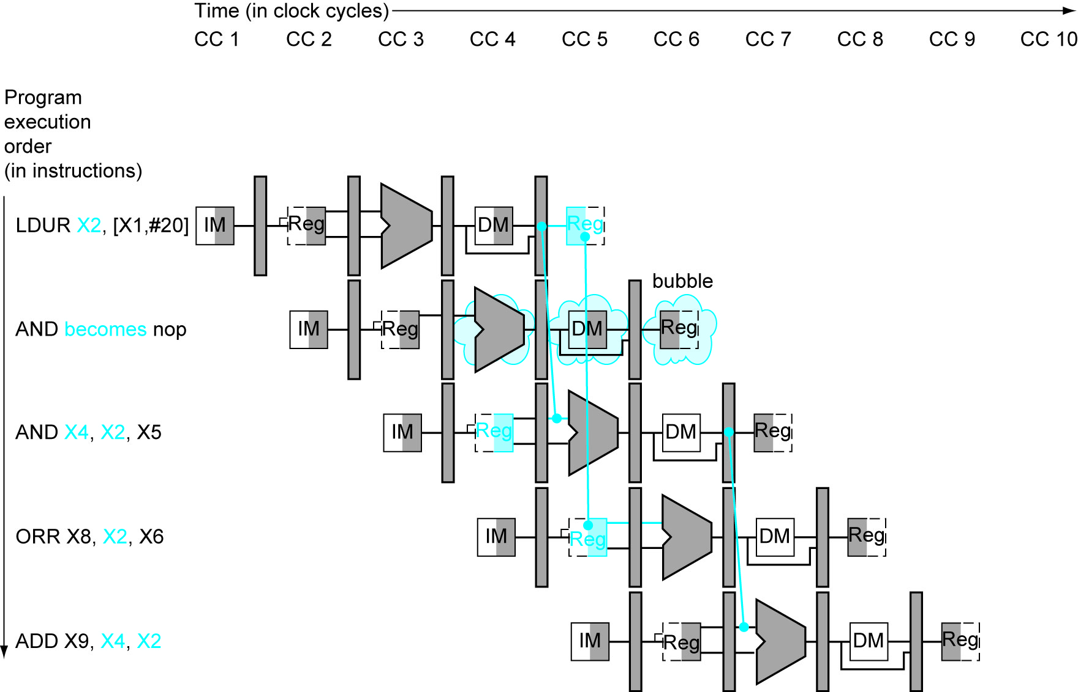

Slide 27
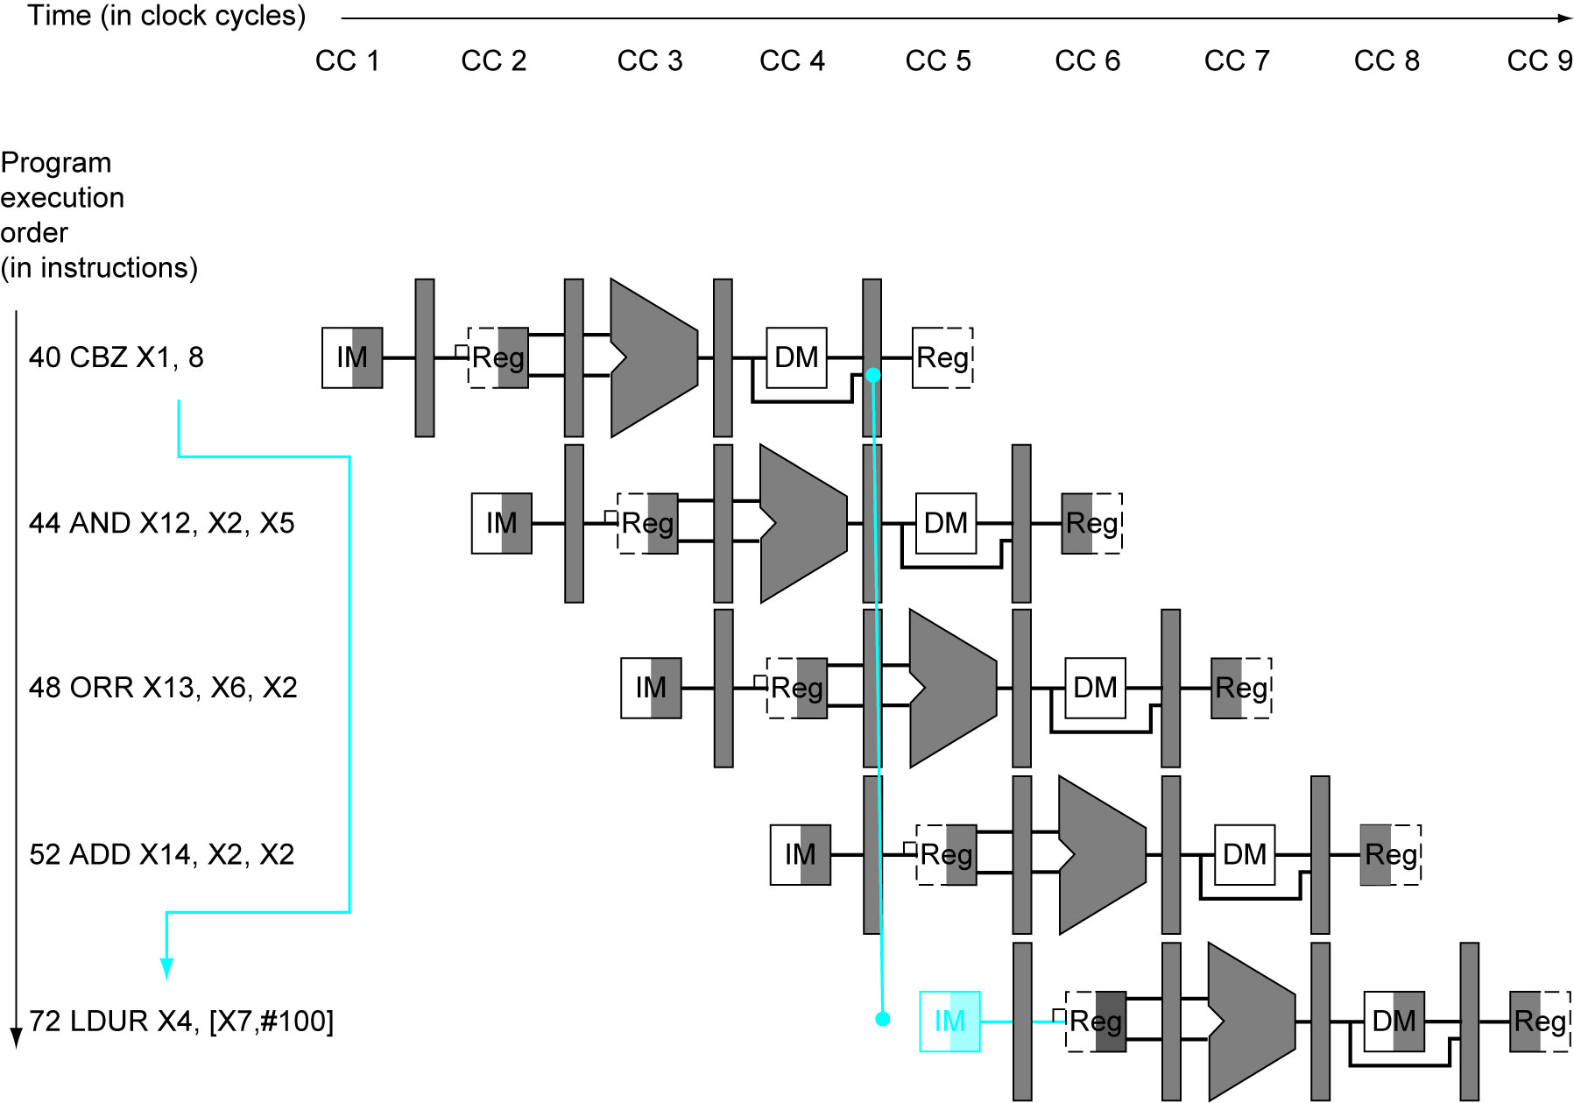

Slide 28
Code Reordering Example
Consider this code
Loop: LDUR X3, [X5, #0]
ADD X7, X7, X3
LDUR X4, [X6 ,#0]
MUL X8, X8, X4
ADD X10, X7, X8
STUR X10, [X5, #0]
ADD X5, X5, #8
ADD X6, X6, #8
SUB X15, X20, X5
CBNZ X15, Loop
We can forward data from R type to next dependent instruction.
But if the data read by LDUR is needed by next instruction, we need to stall.
How many stalls are needed for this code?
sum=0;
product = 1;
for(i=0; i<n; i++) {
sum= sum +a[i];
product = product*b[i];
}

Slide 29
Code Reordering Example
Loop: LDUR X3, [X5, #0]
Stall
ADD X7, X7, X3
LDUR X4, [X6 ,#0]
Stall
MUL X8, X8, X4
ADD X10, X7, X8
STUR X10, [X5, #0]
ADD X5, X5, #8
ADD X6, X6, #8
SUB X15, X20, X5
CBNZ X15, Loop
Stall
Stall
Note since Branch is taken (most of the time), 2 stalls
We need 14 cycles to complete one loop iteration
Can we reorder?
Loop: LDUR X3, [X5, #0]
LDUR X4, [X6 ,#0]
ADD X7, X7, X3
MUL X8, X8, X4
ADD X10, X7, X8
STUR X10, [X5, #0]
ADD X5, X5, #8
ADD X6, X6, #8
SUB X15, X20, X5
CBNZ X15, Loop
Stall
Stall
Now we need 12 cycle per iteration

